Slide 1
Lab on Cell-free Synthetic Biology - EE-490(j)
Seventh Week
28.10.2025

Slide 2
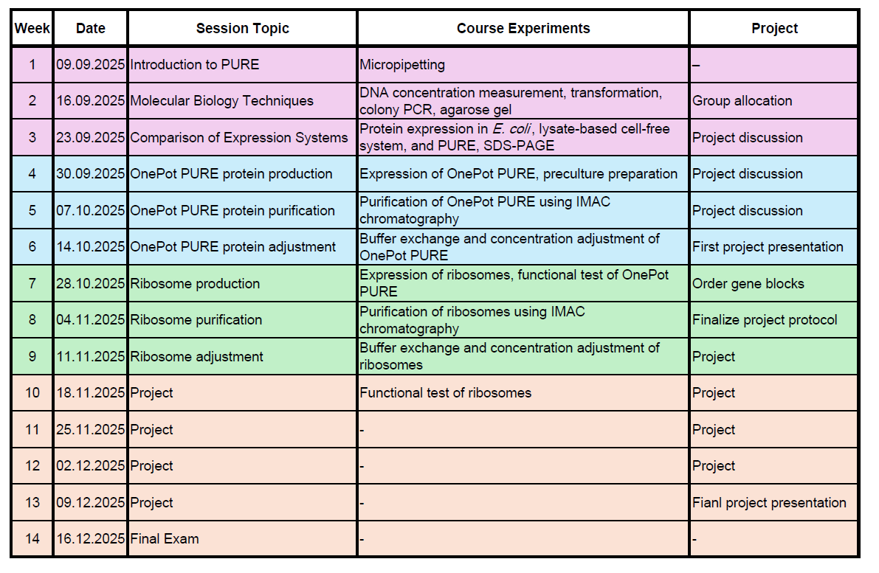
Course schedule

Slide 3
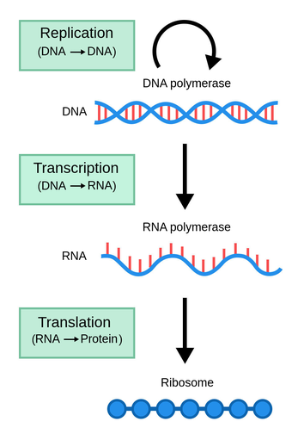
Central dogma

Slide 4
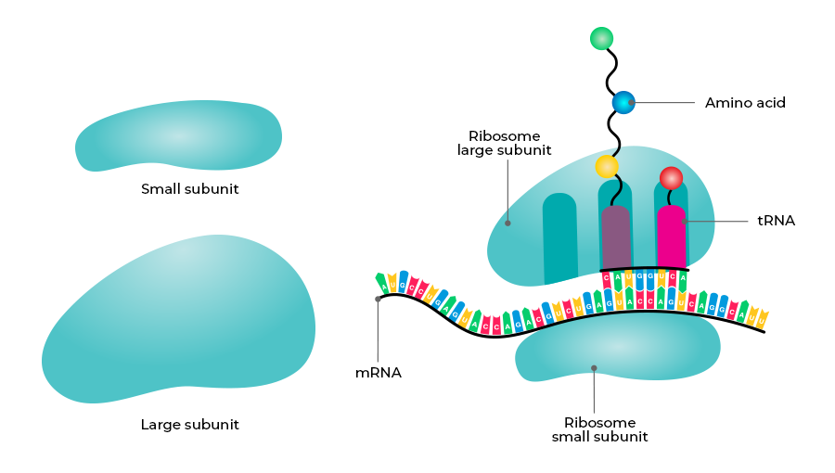
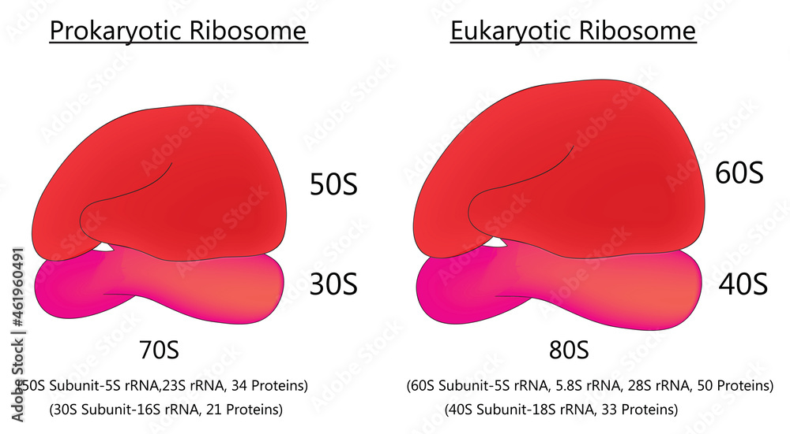
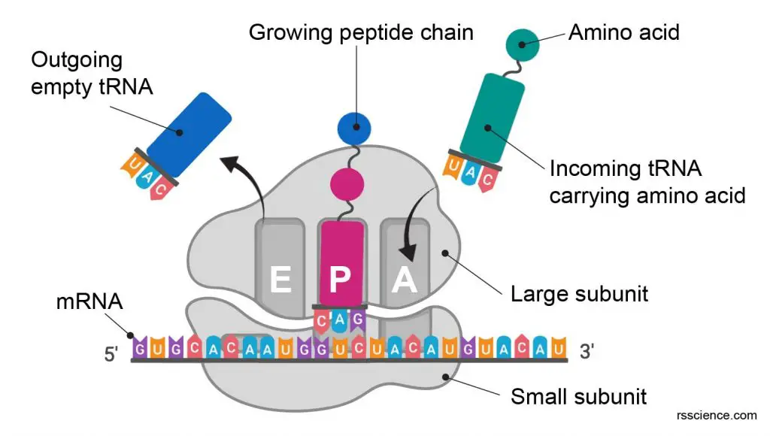
Ribosomes
Site for protein synthesis in cell
Consists of proteins + RNA (rRNA)
Small and Large subunits
S: sedimentation coefficient

Slide 5
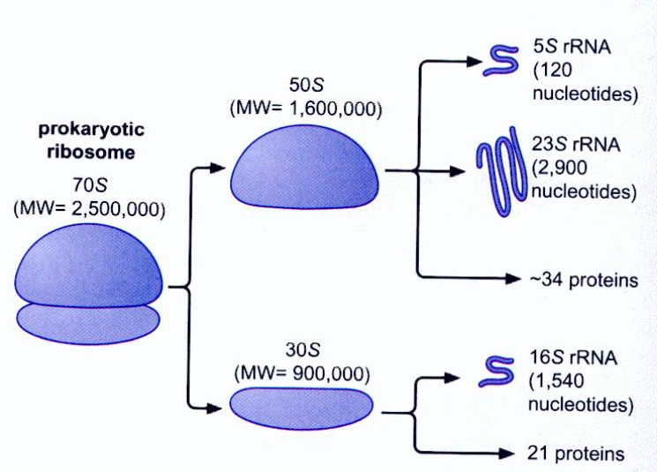
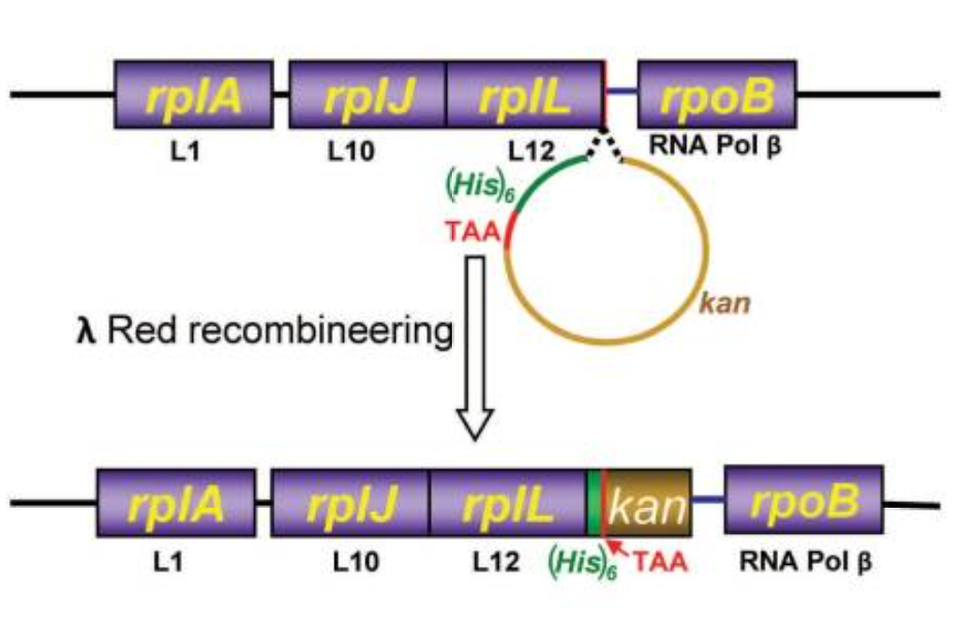
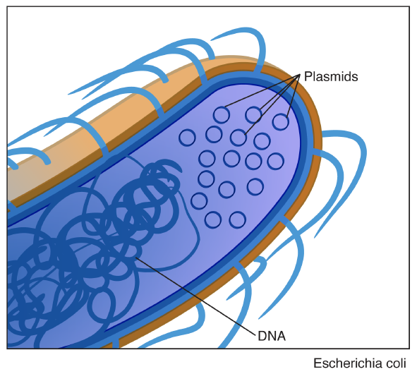

Culturing the cells for ribosome purification
Strain: E. coli JE28
  His-tagged ribosome (6X)
  Genomic insertion of tag at 50S subunit
  Constitutively expressed by cells
Ederth et al., Nucleic Acids Research, 2008

Slide 6
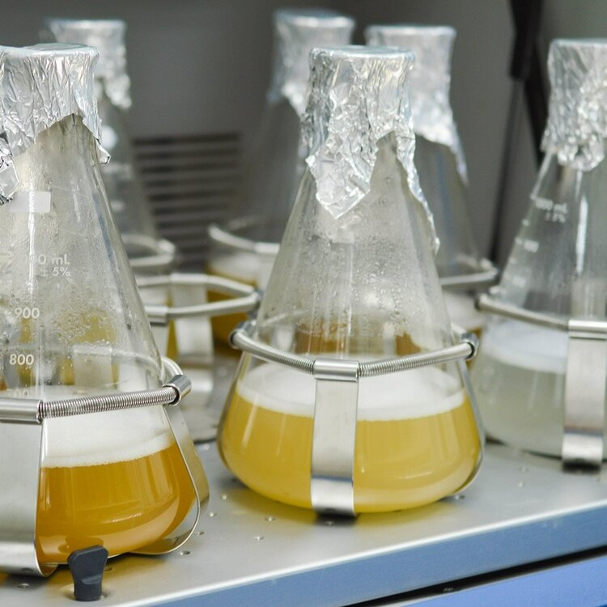
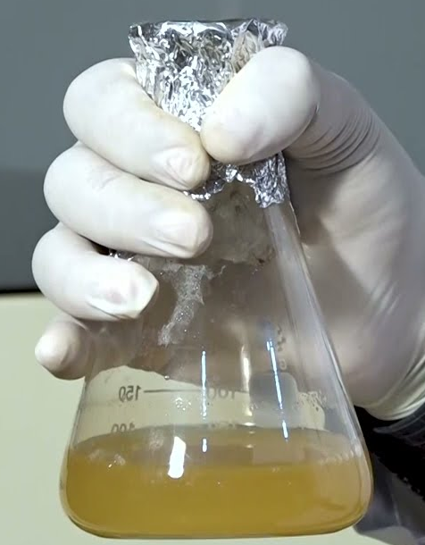
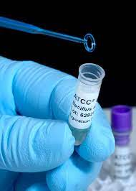
Culturing the cells for ribosome purification
Prepare the overnight culture for cells
  E. coli JE28 strain
Inoculate the main culture
  No need for induction (constitutive promoter)!
14 - 16 h
3 – 4 h
Glycerol stock
Overnight culture
Culture for purification

Slide 7
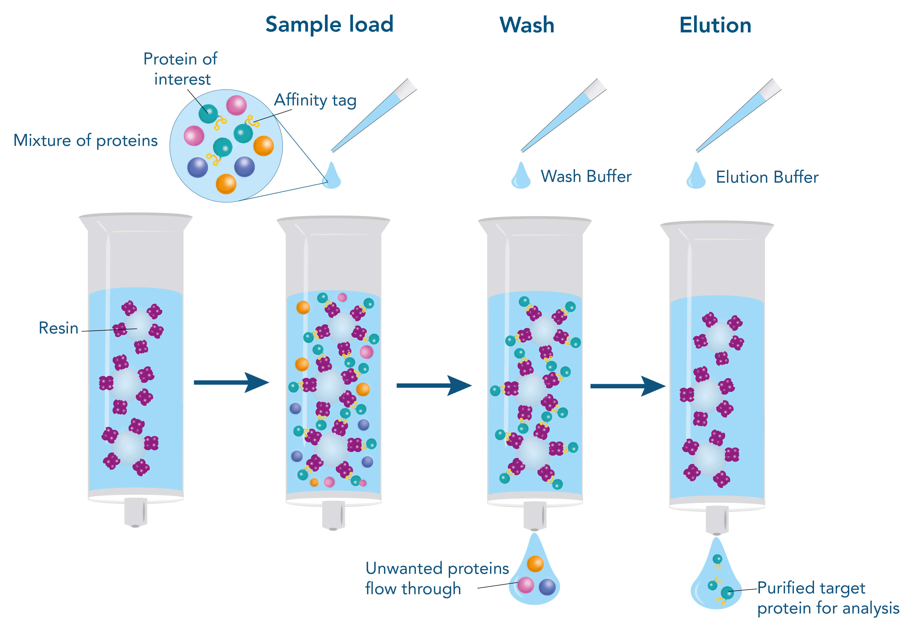
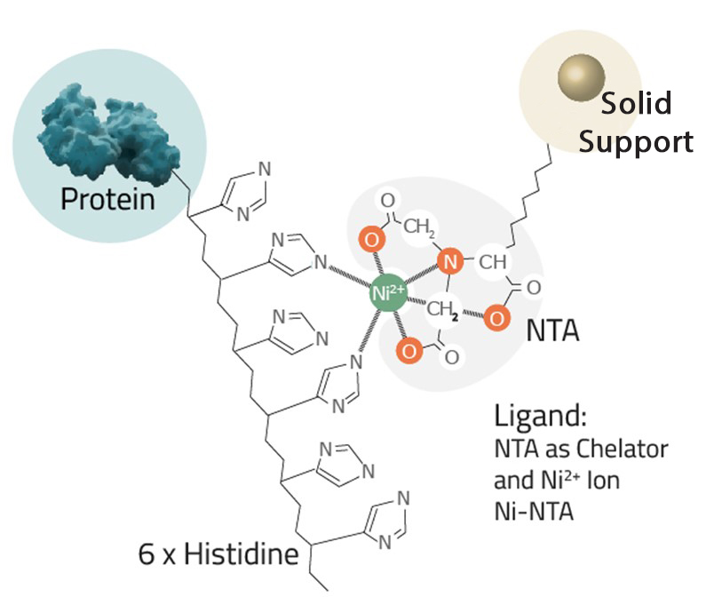
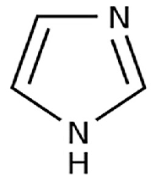

His-tag ribosome purification
Target ribosome
Ribosome
Imidazole
Purified ribosome

Slide 8
By next week
Submit your gene fragment sequences on Moodle (deadline tomorrow night)
Inform me as soon as possible about any other reagents you need
Prepare your detailed experimental protocols (deadline: before the next session)

